Slide 1
Course Introduction
DATA STRUCTURES AND ALGORITHMS

Slide 2

Open a file

Slide 3

Look up a contact on your phone

Slide 4

Do a web search

Slide 5
COURSE CODE | CS106P/CS105L
COURSE TITLE | DATA STRUCTURES AND ALGORITHMS
PRE-REQUISITE | IT 101-2
CO-REQUISITE | None
CREDIT UNIT(S) | Three (3) units
CLASS SCHEDULE | 4.5 hours per week

Slide 6
COURSE DESCRIPTION
This course comprehensively explores data abstractions, core data structures, and algorithms essential for efficient program development. Students will acquire theoretical knowledge and practical experience to ensure algorithm correctness and analyze computational complexities. Topics covered include implementing data structures, algorithm analysis using asymptotic notation, and studying algorithm correctness. By blending theory and practice, students will develop proficiency in designing abstract data types (ADTs) for various structures and making informed algorithmic choices. Further, it also provides a solid foundation in data structures and algorithms, enabling students to design efficient programs and address real-world programming challenges.

Slide 7


Discuss algorithm performance and complexity using asymptotic notation to manage memory effectively and efficiently.
COURSE OUTCOME 1

Slide 8
Demonstrate proficiency in designing and implementing Abstract Data Type ADT-based solutions for diverse data structures and algorithmic paradigms to foster a strong foundation for algorithm development.
COURSE OUTCOME 2

Slide 9
Develop efficient programs that address real-world problems by employing appropriate data structures and algorithmic techniques.
COURSE OUTCOME 3

Slide 10

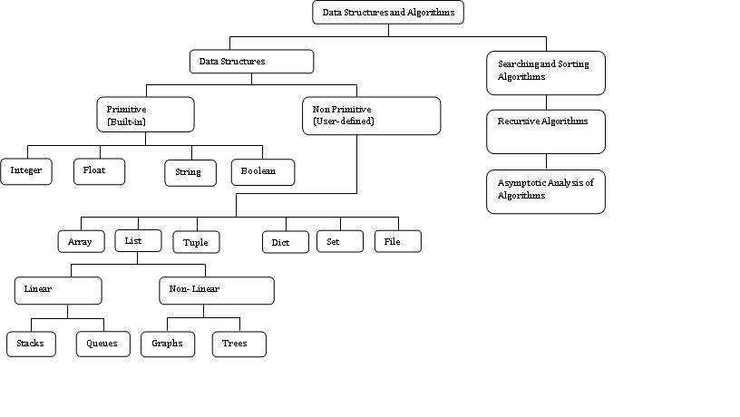

Slide 11
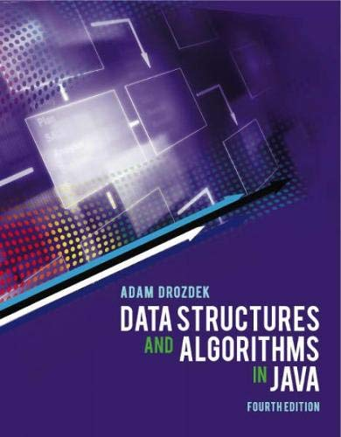
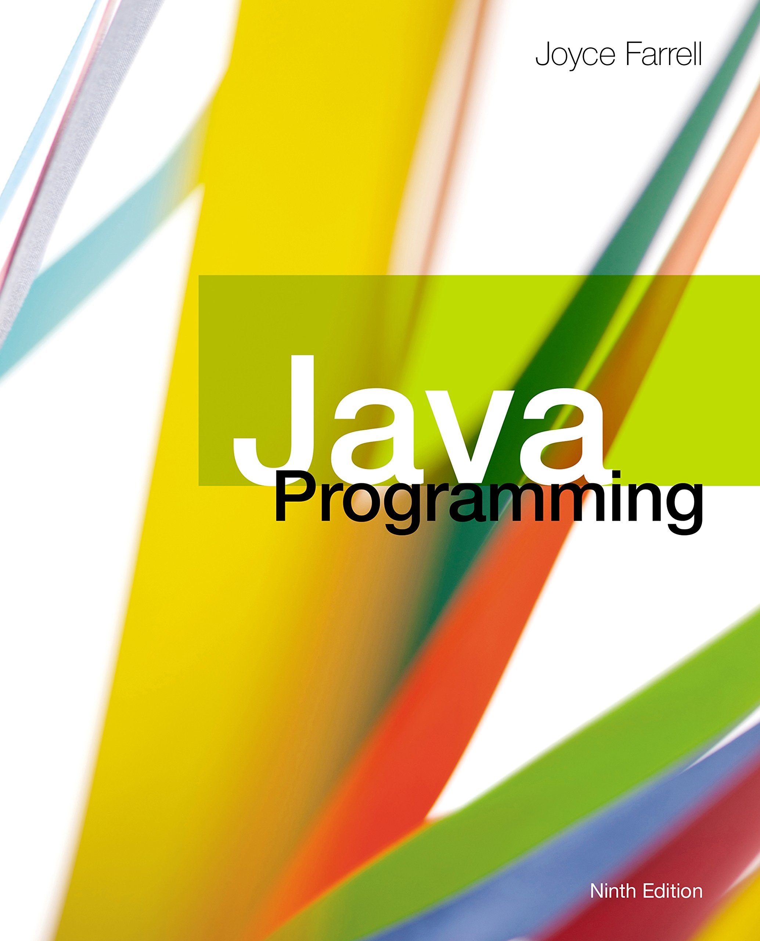
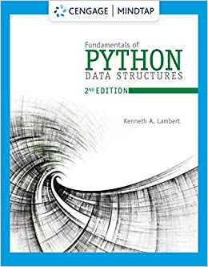
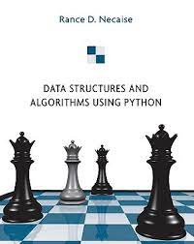

Slide 12

COURSE OUTCOMES 1
MEDIATING OUTCOMES | INTENDED LEARNING OUTCOMES | TOPICS/FORMATIVE ASSESSMENTS
Explain the importance of Data Structures in software development. (MO11) | Understand the underlying concepts of data structures and algorithms Identify different types of Data Structures and their characteristics Analyze the need for choosing and selecting data structures | Week 1: Introduction to Data Structures and Algorithm (DSA). (Chapter 1,4,5) Discussion of Project Specification and Rubrics Overview of Data Structures and Algorithms Importance and relevance of DSA in software development Types of Data Structures FORMATIVE ASSESSMENTS: DSA_Week1_MO11 - Intro to DS and Written Quiz 1
Analyze the complexity of algorithms using time and space complexity analysis. (MO12) | Evaluate program efficiency using T(n) notation. Apply asymptotic notation, including Big O, Omega, and Theta, to analyze algorithm performance. Perform best-case, worst-case, and average-case analyses of algorithms. | Week 2: Algorithm Analysis (Chapter 1,4,5) Analysis of Algorithms: Time and Space Complexity Analysis Asymptotic notation: Big O, Omega, and Theta Big-O notation and its significance Best-case, worst-case, and average-case analysis Recursive algorithms and their analysis FORMATIVE ASSESSMENTS: DSA_Week2_MO12 - Algorithm Complexity, Written Quiz 2, and CASE STUDY 1
Implement Abstract Datatype (ADTs) in creating program solutions. (MO13) | Examine the importance of ADT, its properties, and its operations. Create ADT in solving machine problems Simulate WaterTank ADT | Week 3: Data Abstraction (Chapter 2) Introduction to Abstract Data Types (ADTs) Properties and Operations of ADT WaterTank ADT Application: Create ADT based on real-world scenario/model FORMATIVE ASSESSMENTS: DSA_Week3_MO13 – ADTs, Written Quiz 3, and CASE STUDY 2
Implement Abstract Data Types (ADTs) for encryption algorithms, specifically Caesar Cipher and Vigenère Cipher. (MO14) | Differentiate between symmetric and asymmetric encryption. Apply the Caesar and Vigenère Cipher to encrypt and decrypt messages. Analyze the performance of the Caesar Cipher and Vigenère Cipher algorithms | Week 4: Cryptography (Online) Overview of Cryptography Types of Cryptography Kinds of Encryption : Caesar and Vigenère Cipher Encryption ADT Implementation and Application Performance analysis of Caesar and Vigenère FORMATIVE ASSESSMENTS: DSA_Week4_MO14 – Cryptography, Written Quiz 4, Long Quiz 1 (Review), and CASE STUDY 3
M1 Summative Assessments (Mandatory Face to Face) – Written and Hands-on

Slide 13
COURSE OUTCOMES 2
MEDIATING OUTCOMES | INTENDED LEARNING OUTCOMES | TOPICS/FORMATIVE ASSESSMENTS
Analyze the performance of different sorting techniques. (MO21) | Identify different sorting techniques and algorithms. Develop (ADTs) for each sorting algorithm. Examine performance analysis of sorting algorithms. | Week 6: Sorting Algorithm (Chapter 13) Definition The need for sorting data Different Sorting techniques/algorithms Bubble, insertion, selection, insertion, etc ADT Implementation and Application Performance analysis of sorting algorithms FORMATIVE ASSESSMENTS: DSA_Week6_MO21 - Sorting Algorithms, Written Quiz 5, and CASE STUDY 4
Implement Stack ADT Linear Data Structures/Algorithm using an array-based structure. (MO22) | Identify the concepts and operations associated with Stack. Design ADTs for Stack data structures. Evaluate the performance analysis of Stack algorithms. | Week 7: Stack (Chapter 6) Stack Definition Stack Operations Stack ADT Implementation and Application Performance analysis of Stack algorithms FORMATIVE ASSESSMENTS: DSA_Week7_MO22 - Stack ADT, Written Quiz 6, and CASE STUDY 5
Implement Queue Linear Data Structures/Algorithms using an array-based structure. (MO23) | Identify the concepts and operations associated with Queue. Design ADTs for Queue data structures. Evaluate the performance analysis of Queue algorithms. | Week 8: Queue (Chapter 6) Queue Definition and Concepts Queue Properties and Operations ADT Queue Implementation and Application Performance analysis of Queue algorithms FORMATIVE ASSESSMENTS: DSA_Week8_MO23 - Queue ADT, Written Quiz 7, Long Quiz 2 (Review), and CASE STUDY 6
M2 Summative Assessments (Mandatory Face to Face) – Written and Hands-on

Slide 14
COURSE OUTCOMES 3
MEDIATING OUTCOMES | INTENDED LEARNING OUTCOMES | TOPICS/FORMATIVE ASSESSMENTS
Implement LinkedList ADT Linear Data Structures/Algorithm using a dynamic-based structure. (MO23) | Demonstrate an understanding of LinkedList operations, including insertion, deletion, and traversal. Implement ADTs for LinkedList data structures. Evaluate the performance analysis Linkedlist operations. | Week 10: LinkedList Algorithms (Chapter 3) Types of LinkedList (Singly, Doubly, and Circular LinkedList) Operations (insertion, deletion, traversal) ADT Implementation and Application Performance analysis of LinkedList algorithms FORMATIVE ASSESSMENTS: DSA_Week10_MO31 - LinkedList ADT, Written Quiz 8, and CASE STUDY 7
Build ADTs for Binary Tree (M032) | Identify the properties and operations of the Binary Tree structure Perform Breadth-first and depth-first Traversals Develop ADT on Binary Tree structures | Week 11: General Tree and Binary Trees (BT) (Chapter 8) Types of BT BT Operations and Traversals Breadth-first (Level Order Traversal) Dept-first (Inorder, PreOrder, Postorder) ADT Implementation and Application Performance analysis of BT operations FORMATIVE ASSESSMENTS: DSA_Week11_MO32 - Binary Tree ADT, Written Quiz 9, and CASE STUDY 8
Build ADTs for Binary Search Tree (M033) | Identify the properties and operations of the Binary Search Tree structure Perform Breadth-first and depth-first Traversals Develop ADT on Binary Search Tree structures | Week 12: Binary Search Trees (BST) (Chapter 11) BST Operations BST Cases deletions BST Traversals ADT Implementation and Application Performance analysis of BST operations FORMATIVE ASSESSMENTS: DSA_Week12_MO33 - Binary Search Tree ADT, Written Quiz 10, and CASE STUDY 9
Build ADTs for Binary Heaps and Priority Queues algorithm (M034) | Identify the properties and operations of Binary Heaps Develop ADT on Binary Heap structures Implement Priority Queues through Binary Heap | Week 13: Heaps and Priority Queues (Chapter 9) Properties of Binary Heaps Heap operations (insertion, deletion, heapify) Priority queues and their applications FORMATIVE ASSESSMENTS: DSA_Week13_MO34 - Binary Heaps and Priority Queues and Long Quiz 3 (Review)
M3 Summative Assessments (Mandatory Face to Face) – Project Presentation

Slide 15



Programming Language

Slide 16






Integrated Development Environment

Slide 17
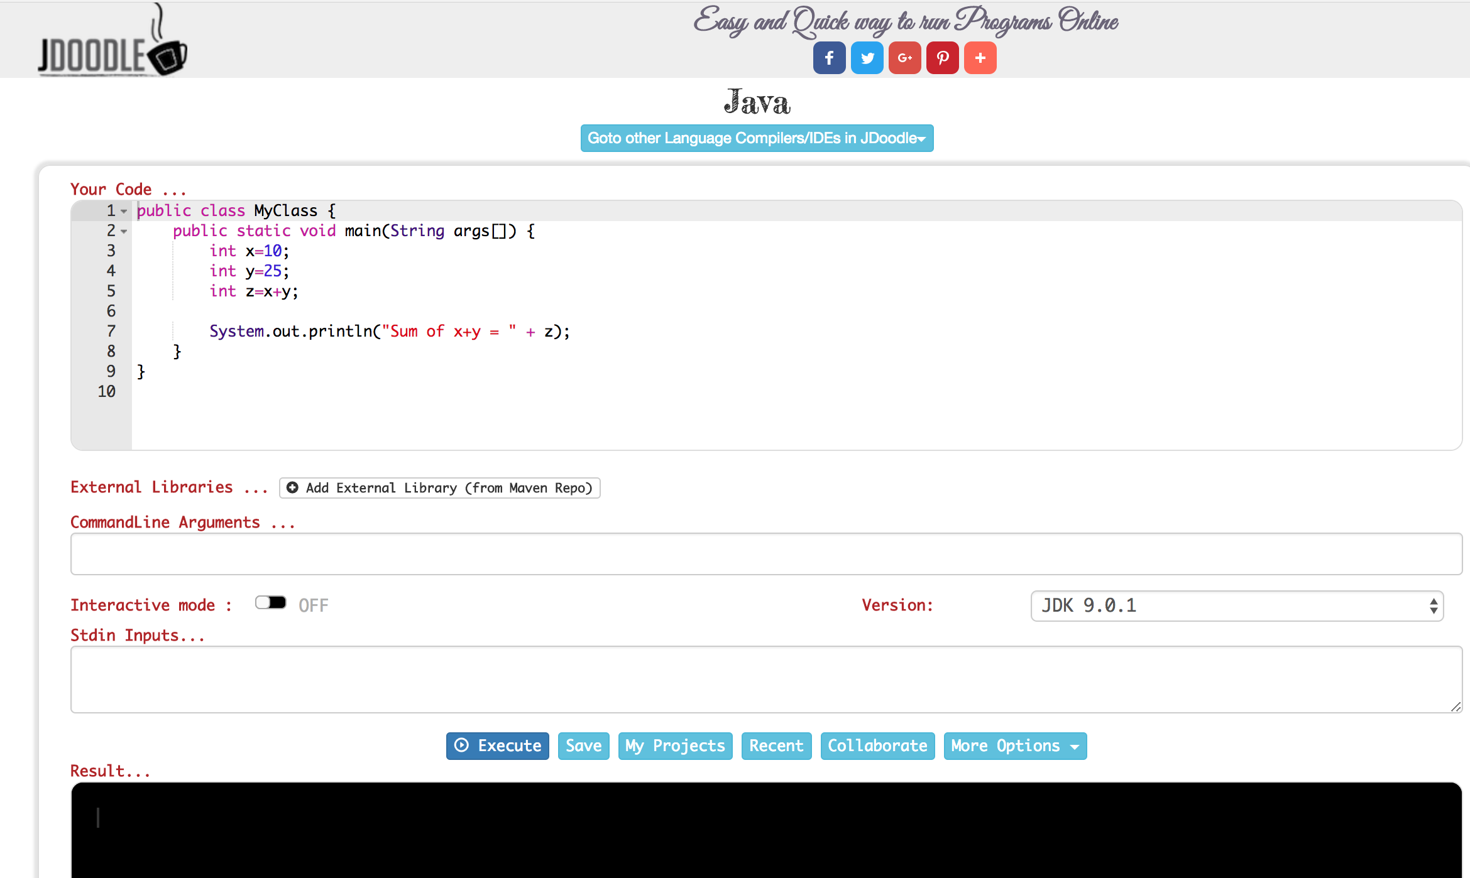
https://www.jdoodle.com/online-java-compiler/
Online Tools

Slide 18
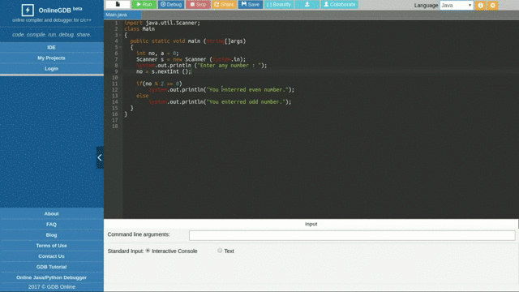
https://www.onlinegdb.com/online_java_compiler
Online Tools

Slide 19
Recommendation

Slide 20
Thank you!
Martzel Baste
CCIS Department

